Slide 1
Scientific Machine Learning for Modeling, Optimization, and Control of Dynamical Systems
Ján Drgoňa
Associate Professor Civil and Systems Engineering Department The Ralph O'Connor Sustainable Energy Institute (ROSEI)
Data Science and AI Institute (DSAI)

Slide 2
Course Syllabus
Week 1: Introduction to Scientific Machine Learning (SciML)
Week 2: Preliminaries and Introduction to differentiable programming
Week 3: Physics-informed neural networks (PINNs)
Week 4: Neural ordinary differential equations (NODEs)
Week 5: Learning to optimize (L2O)
Week 6: Differentiable control
Week 7: Neural differential equations with constraints
Week 8: Feasibility restoration methods in L2O
Week 9: Safety filters for learning-based control
Week 10: SciML applications
Week 11: Project evaluation with presentations
Week 12: Project evaluation with presentations

Slide 3
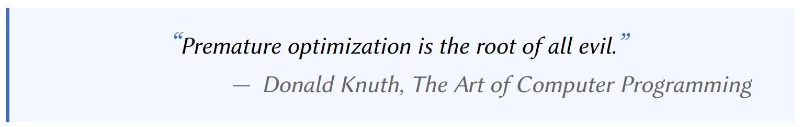

Learning to Optimize (L2O) with Constraints
Pascal Van Hentenryck, Optimization learning, arXiv:2501.03443, 2025
James Kotary, et al., End-to-End Constrained Optimization Learning: A Survey, IJCAI, 2021
R. Sambharya, et al., End-to-End Learning to Warm-Start for Real-Time Quadratic Optimization, 2022
M. Li, et al., Learning to Solve Optimization Problems with Hard Linear Constraints, 2022
S. Gould, et al., Deep Declarative Networks: A New Hope, 2020

Slide 4
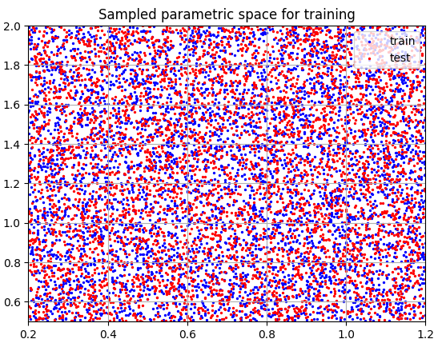
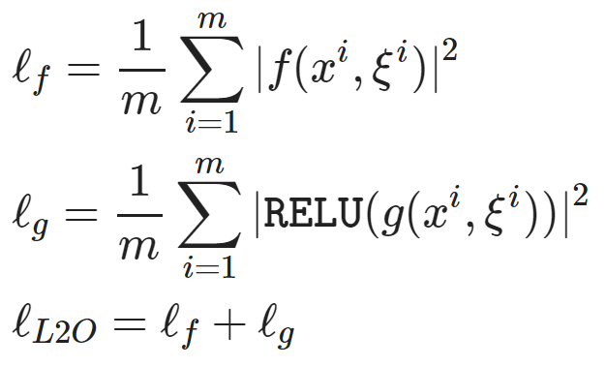
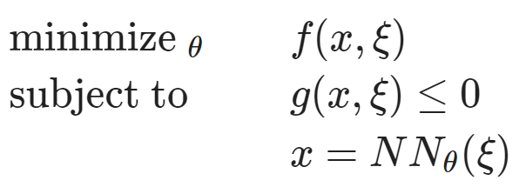
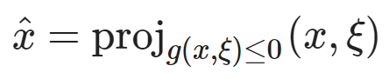
Overview of Learning to Optimize (L2O) with Constraints
Dataset: collocation points in the parametric space.
Architecture: differentiable optimization solver with neural network surrogate.
Loss function: minimizing objective function and constraints penalties.
https://github.com/pnnl/neuromancer/blob/master/examples/parametric_programming/Part_1_basics.ipynb
A. Agrawal, et al., Differentiable Convex Optimization Layers, 2019
P. Donti, et al., DC3: A learning method for optimization with hard constraints, 2021

Slide 5
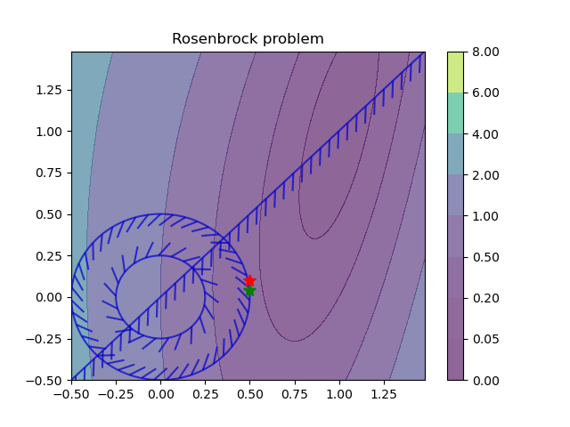
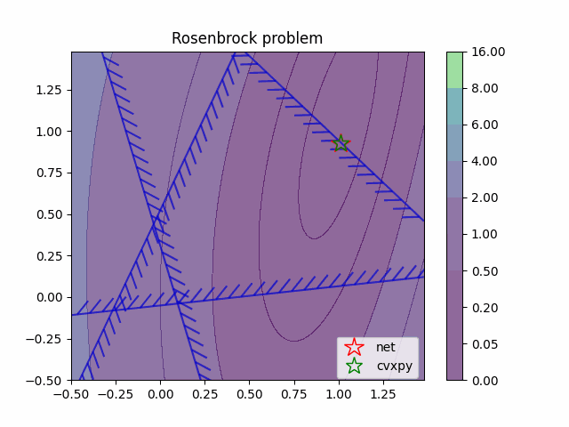
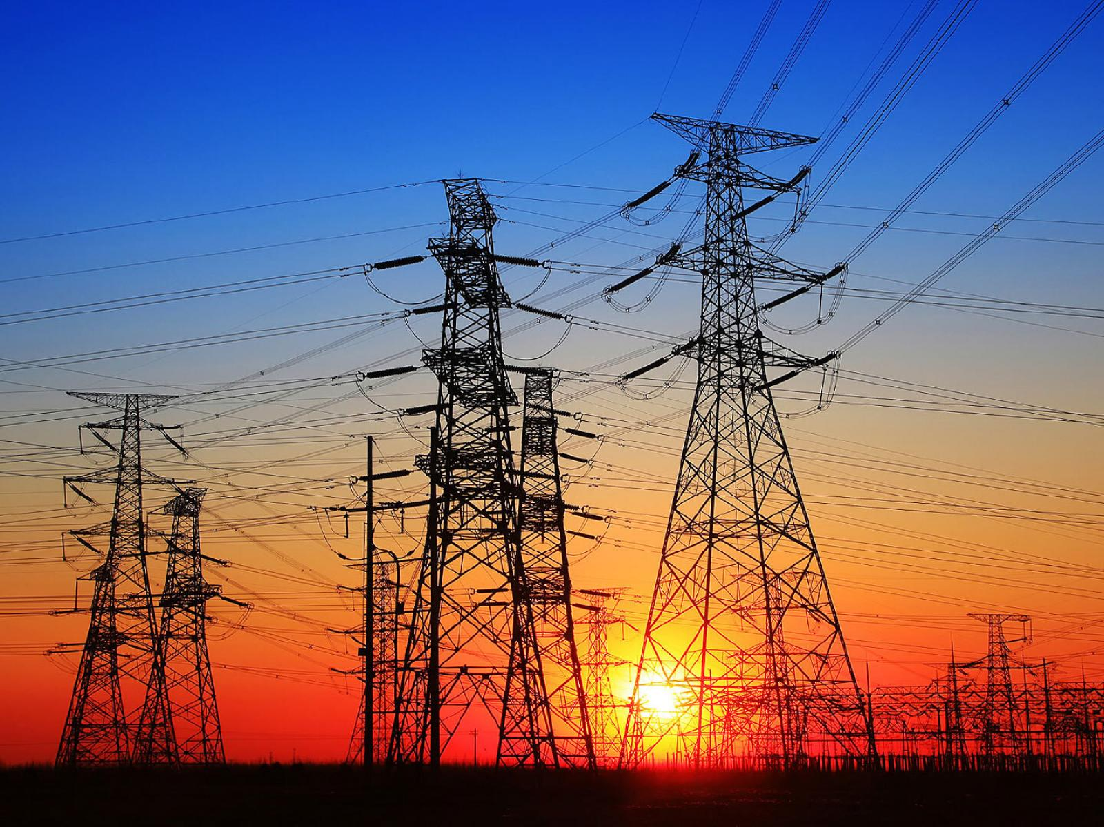
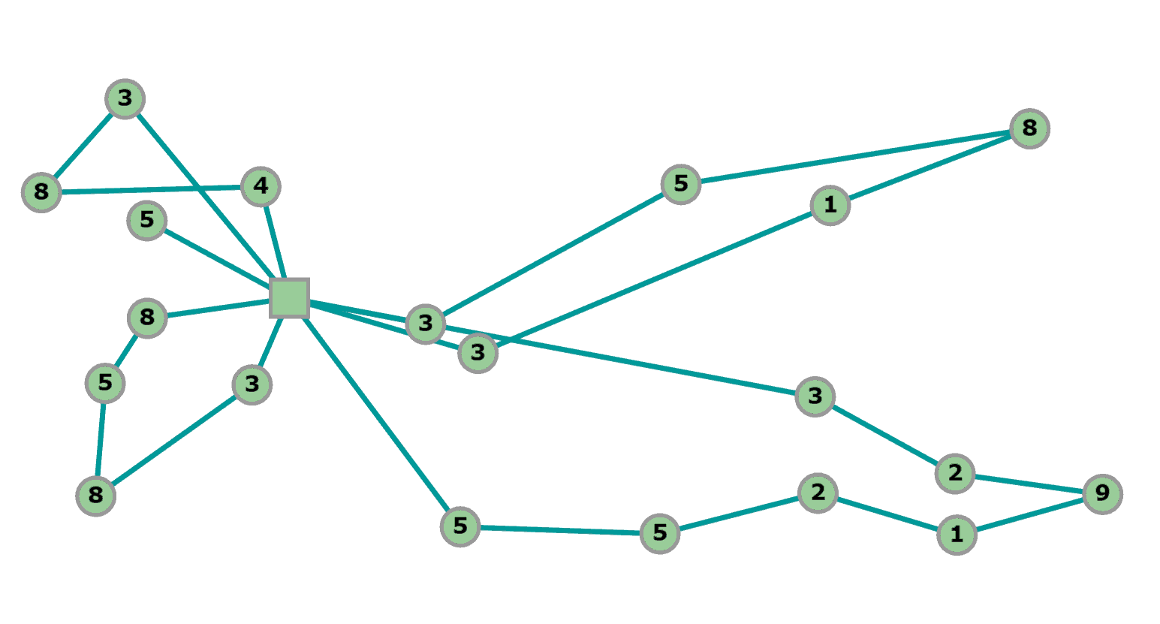
Applications of Learning to Optimize (L2O) with Constraints
Fast real-time optimization surrogates
Power systems operations
Scheduling and routing problems
He He, et al., Learning to search in branch and bound algorithms. NeurIPS, 2014.
Elias Khalil, et al., Learning to branch in mixed integer programming. AAAI Conference on AI, 2016.
Agrawal, A. and Amos, B. and Barratt, S. and Boyd, S. and Diamond, S. and Kolter, Z., Differentiable Convex Optimization Layers, NeurIPS 2019
F. Fioretto, et al., Predicting AC Optimal Power Flows: Combining Deep Learning and Lagrangian Dual Methods, 2019
Maxime Gasse, et al., Exact combinatorial optimization with graph convolutional neural networks. NeruIPS, 2019.
Andre Hottung and Kevin Tierney, Neural Large Neighborhood Search for the Capacitated Vehicle Routing Problem, ECAI 2020
A. S. Zamzam and K. Baker, Learning Optimal Solutions for Extremely Fast AC Optimal Power Flow, IEEE SmartGridComm, 2020
P. Donti, et al., DC3: A learning method for optimization with hard constraints, 2021
Timo Berthold , et al., Learning to scale mixed-integer programs. AAAI Conference on AI, 2021.
Yoshua Bengio, et al., Machine learning for combinatorial optimization: a methodological tour d’horizon. European Journal of Operational Research, 2021.
M. Li, et al., Learning to Solve Optimization Problems with Hard Linear Constraints, 2022
Dimitris Bertsimas and Bartolomeo Stellato. Online mixed-integer optimization in milliseconds. INFORMS Journal on Computing, 2022. Bo Tang, Elias B. Khalil, Ján Drgoňa, Learning to Optimize for Mixed-Integer Non-linear Programming, arXiv:2410.11061, 2024
Pascal Van Hentenryck, Optimization learning, arXiv:2501.03443, 2025

Slide 6
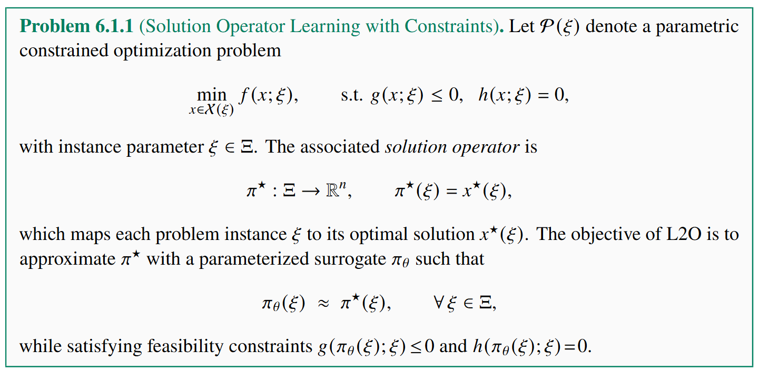
L2O Problem Formulation

Slide 7
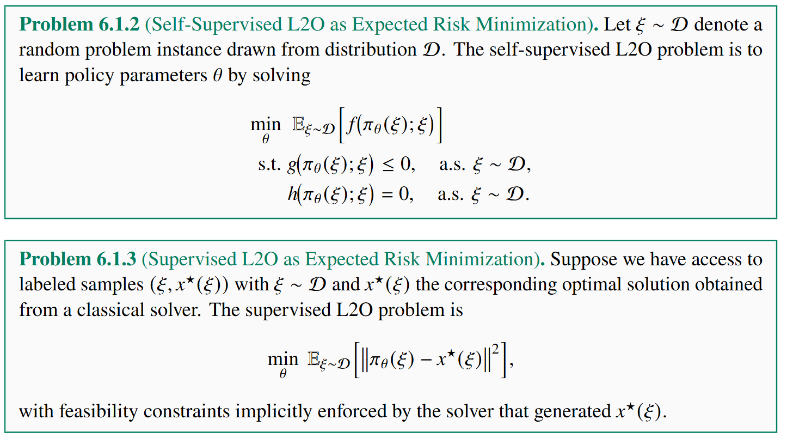
Supervised vs Self-Supervised L2O

Slide 8
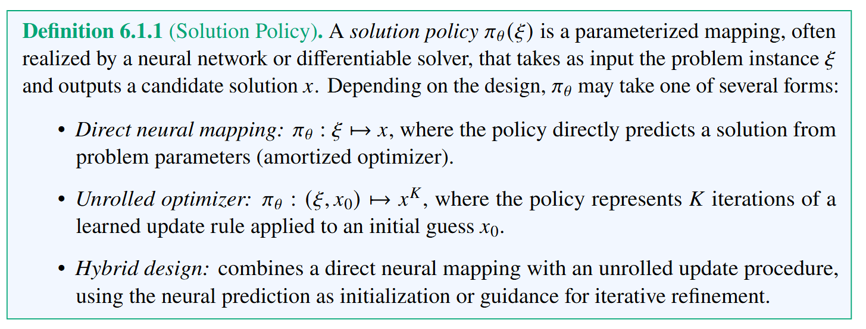
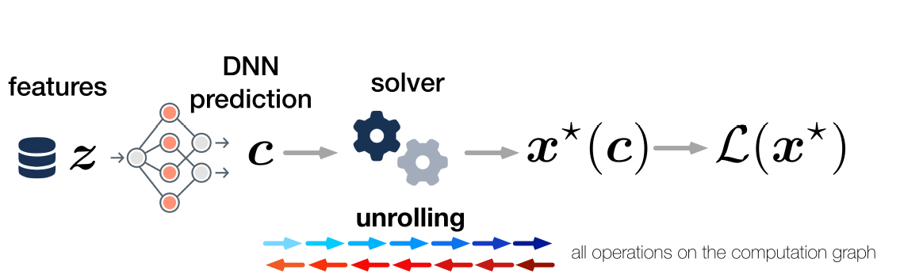
L2O Policy Representation
James Kotary, My H. Dinh, Ferdinando Fioretto, Backpropagation of Unrolled Solvers with Folded Optimization, IJCAI, 2023

Slide 9
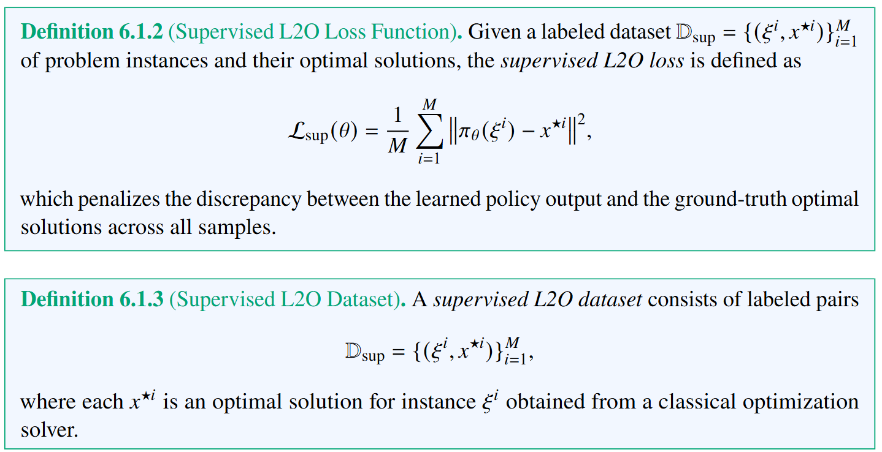
Supervised L2O Loss Function and Dataset

Slide 10
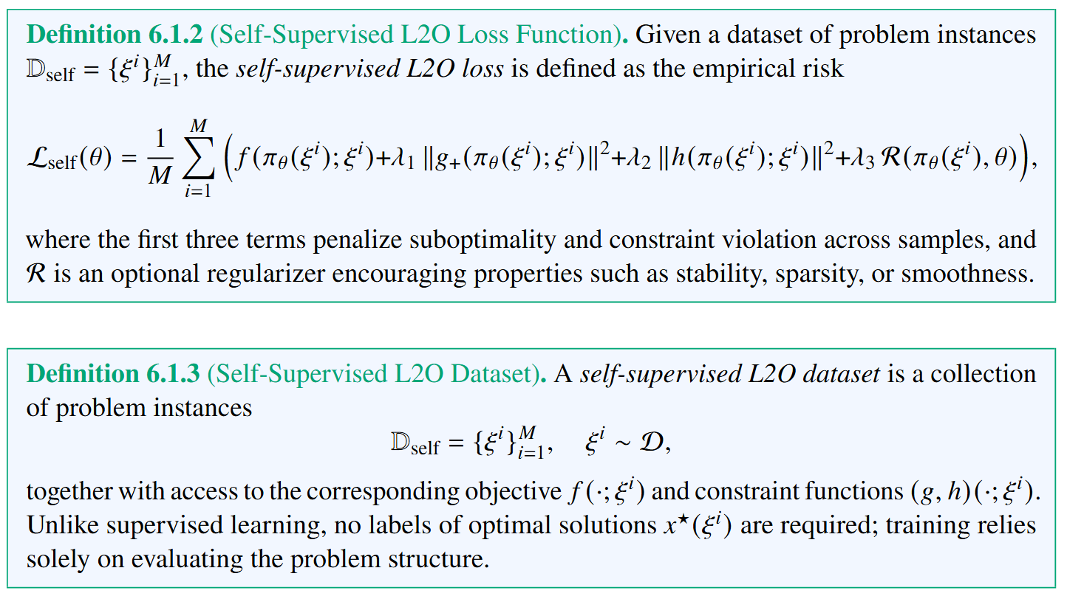
Self-Supervised L2O Loss Function and Dataset

Slide 11
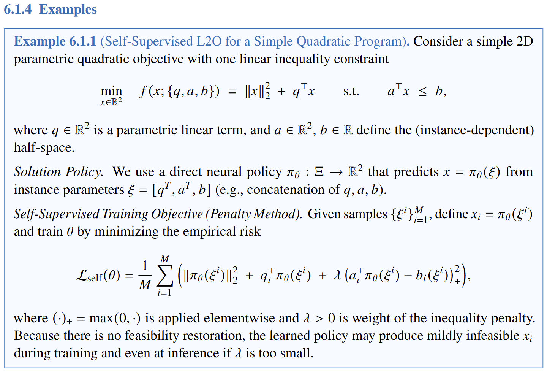
L2O Example

Slide 12
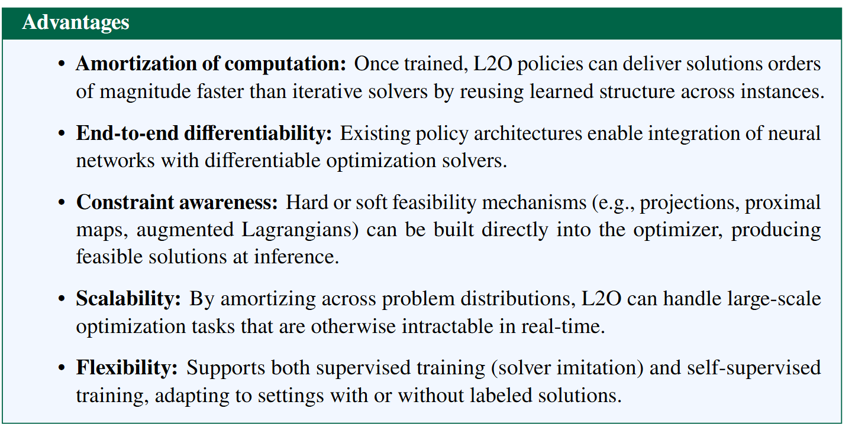
L2O Advantages

Slide 13
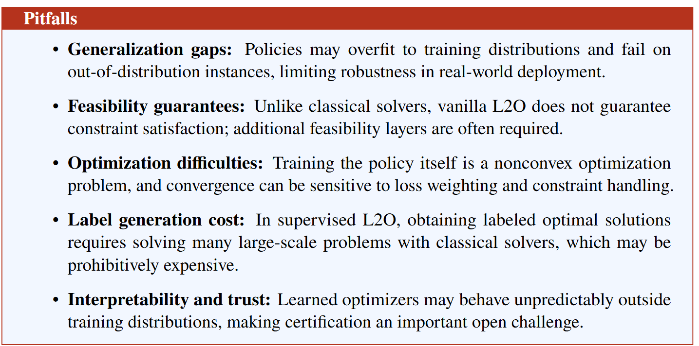
L2O Disadvantages

Slide 14






Optimization Modeling Languages and Solvers
https://www.pyomo.org/
https://www.cvxpy.org/
https://jump.dev/JuMP.jl/stable/
https://web.casadi.org/
https://gekko.readthedocs.io/
https://www.gurobi.com/

Slide 15

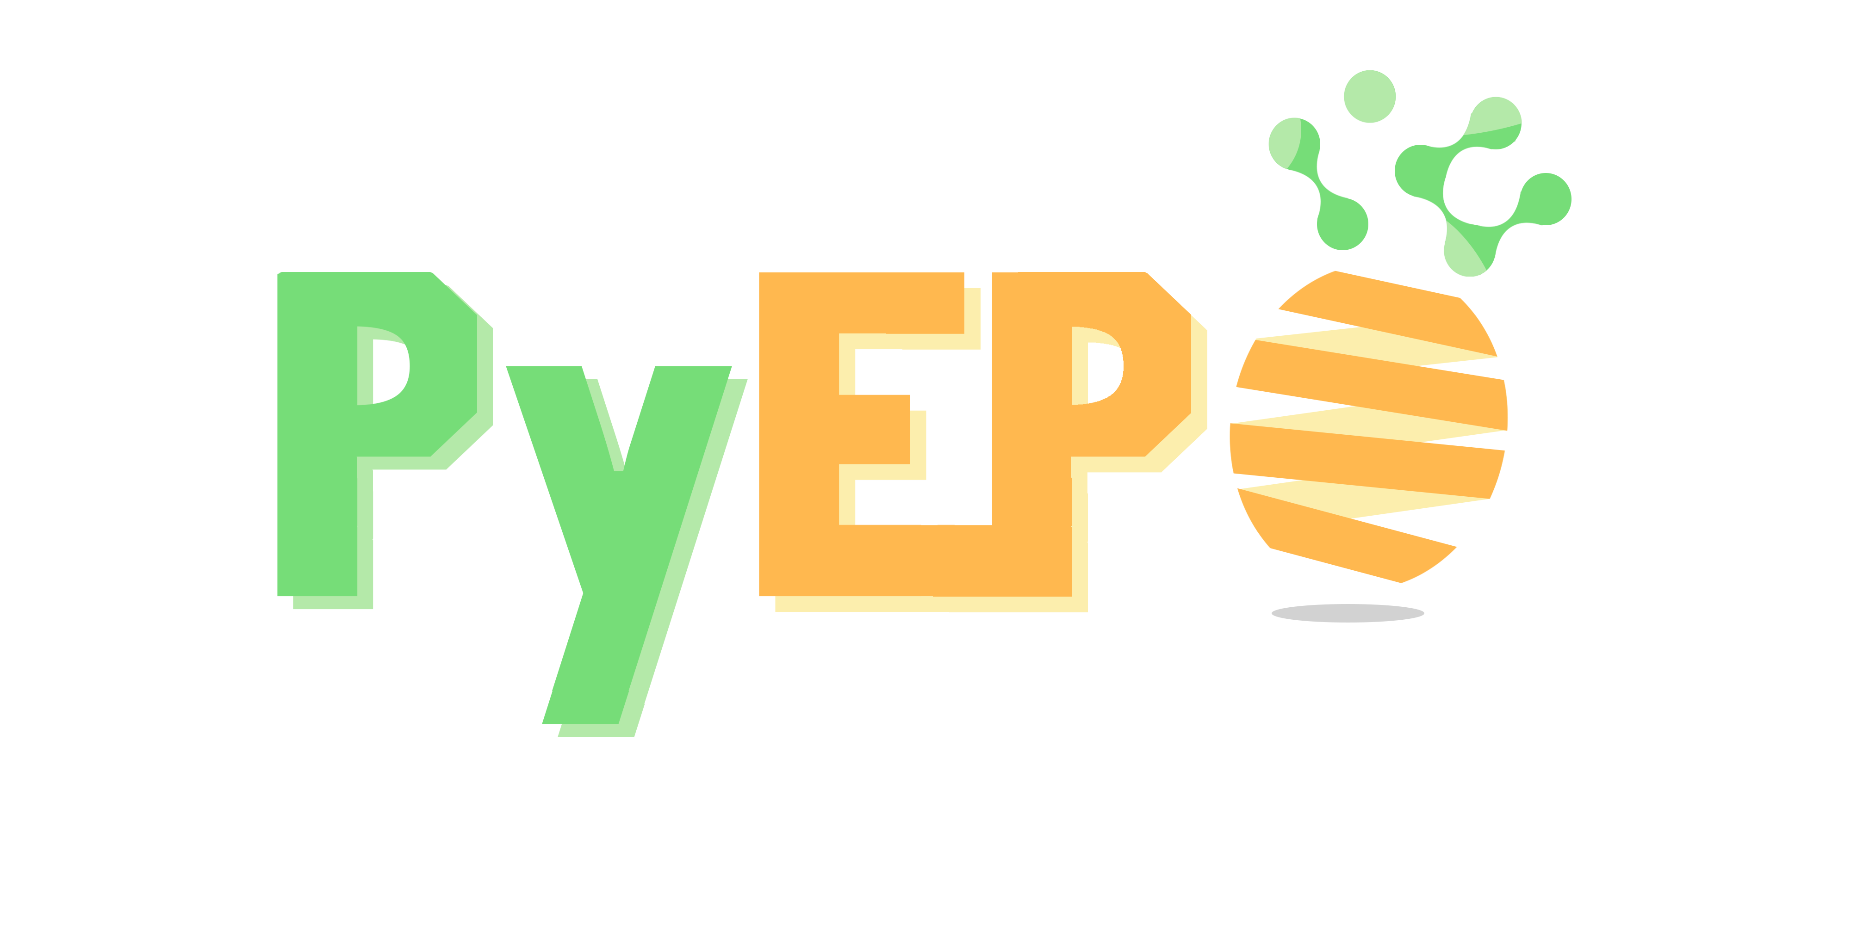
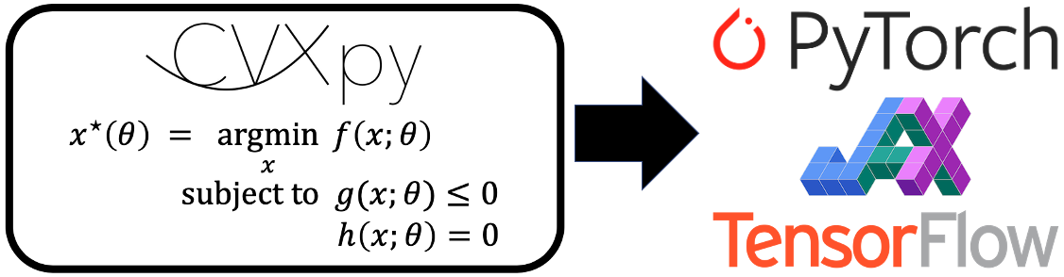


Differentiable Optimization and L2O Libraries
github.com/cvxpy/cvxpylayers
github.com/khalil-research/PyEPO
github.com/pnnl/neuromancer
Opt
DiffOpt
github.com/google/jaxopt
github.com/facebookresearch/theseus
github.com/jump-dev/DiffOpt.jl

Slide 16

L2O in NeuroMANCER Scientific Machine Learning Library
L2O Examples
L2O for a constrained optimization problem.
L2O for a quadratically-constrained optimization problem.
L2O for a set of 2D constrained optimization problems.
L2O for a constrained optimization problem with the projected gradient.
L2O with Cvxpylayers for differentiable projection onto the feasible set.
L2O with metric learning using Operator Splitting layers.
github.com/pnnl/neuromancer

Slide 17
Homework Assignment: Project Proposal
Project proposal: Write a 2-page long proposal 11pt font for your semester project written either using word or pdf generated using Latex.
The proposal must include following paragraphs:
Summary: Single sentence providing concise overview of the proposal.
Introduction: Provides context and problem statement. Answers what is the problem and why is the problem important.
Objectives: States clear and specific objectives of the proposal. Answers what we want to achieve.
Technical approach: Detailed explanation of how the project will be executed. Provides steps, strategies, and techniques to be used. Answers how are we going to achieve our objectives.
Expected outcomes: Key results expected from the project. Performance indicators and success metrics.

Slide 18
Week 11: Project Presentations and Evaluation
Projects cover 70% of the course grade!
Project proposal 20% - week 5
Project progress report 10% - week 8
Project final report 20% - week 10
Project presentation 20% - week 11
Project format.
Project technical report: 4 to 6 page long pdf document including references and figures.
Project presentation: ppt or pdf slides, 15 min time slot per student in week 11.
Admissible topics.
Application of selected SciML methods to problems inspired by real-world applications
e.g., L2O for large scale optimization of energy systems.
Development of new methods tackling some of the open challenges in SciML
e.g., novel way of utilizing PINNs in differentiable control for PDEs.
New theory supporting selected SciML methodology
e.g., convergence analysis of feasibility restoration layers in L2O.

